Slide 1
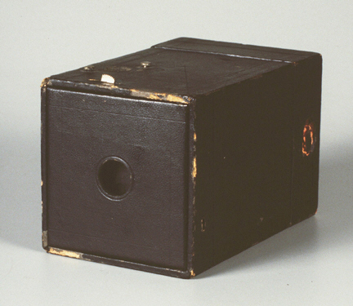
Viewing
Part II (The Synthetic Camera)
Brownie camera courtesy of http://www.geh.org/fm/brownie2/htmlsrc/mE13000034_ful.html
<number>/31

Slide 2
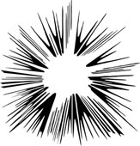
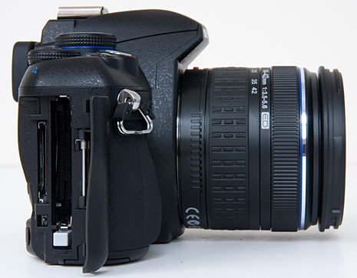
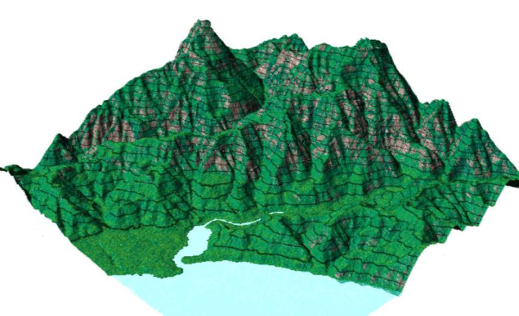
The camera and the scene
What does a camera do?
  Takes in a 3D scene
  Places (i.e., projects) the scene onto a 2D medium (a roll of film or a digital pixel array)
The synthetic camera is programmer’s model for specifying how a 3D scene is projected onto screen
Contour map courtesy of http://www.princeton.edu/~oa/manual/mapcompass.shtml
<number>/31

Slide 3
3D Viewing: The Synthetic Camera
General synthetic camera: each package has its own but they are all (nearly) equivalent, with the following parameters/Degrees of Freedom (DoF)
  Camera position
  Orientation
  Field of view (angle of view, e.g., wide, narrow/telephoto, normal...)
  Depth of field/Focal distance (near distance, far distance)
  Tilt of view/ film plane (if not perpendicular to viewing direction, produces oblique projections)
  Perspective of parallel projection (camera near objects or infinite distance away, resp.)
CS123 uses a simpler slightly less powerful model than the one used in the book
  Omit tilt of view/film plane, i.e., no oblique projections, focal distance (blurring)
<number>/31

Slide 4
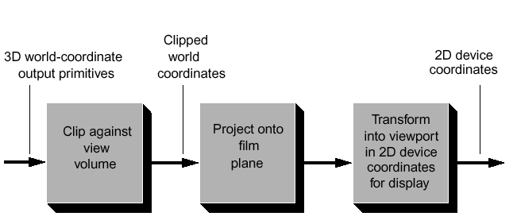
Cameras in Rendering Process
Will detail coordinate systems for camera, i.e., view volume specification, projecting onto film plane, and transforming into viewport
Let’s first define viewport and view volume
<number>/31

Slide 5
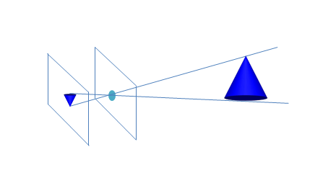
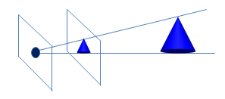
The pinhole model
Our camera is related to a pinhole. As you look through pinhole see a certain volume of space
Rays of light reflect off objects and converge to pinhole to let you see the scene on a film plane or wall behind the pinhole. The scene will be inverted.
The pinhole is where our camera position will be (“Center of Projection”) and volume we see will be our “view volume”
In our camera, projectors intersect
a plane, usually in between
scene and pinhole, to get
projected onto that plane
Lastly, in synthetic camera
projection is mapped
to some form of viewing medium
(screen)
Pinhole Camera
Object
Image
Pinhole
Synthetic Camera
Object
Pinhole
Image
<number>/31

Slide 6
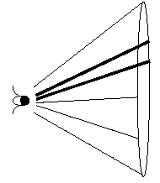
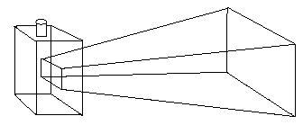
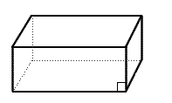
View Volumes (focus of today’s lecture)
conical perspective view volume (eye’s is much wider, e.g., >= 180 degrees, esp. for motion!)
A view volume contains everything the camera sees
Conical – Approximates what eyes see, expensive math when clipping objects against cone’s surface (simultaneous linear and quadratics)
Can approximate this using a rectangular frustum view volume
  Simultaneous linear equations for easy clipping of objects against sides (stay tuned for clipping lecture next time)
Also parallel view volumes, e.g., for orthographic projections. These don’t simulate eye or camera
eye
Frustum: approximation to conical view volume
synthetic
camera
View volume
(Parallel view)
<number>/31

Slide 7
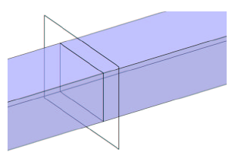
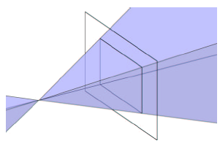
View Volumes and Projectors
Given our view volume, need to start thinking about how to project scene contained in volume to film plane
Projectors: Lines that essentially map points in scene to points on film plane
Parallel Volumes: Parallel Projectors, no matter how far away an object is, as long as it is in the view volume it will appear as same size, (using our simple camera model, these projectors are also parallel to look vector, the direction in which the camera is looking)
Perspective Volumes: Projectors emanate from eye point = center of projection, inverse of rays of light converging to your eye (Dürer woodcut)

Slide 8
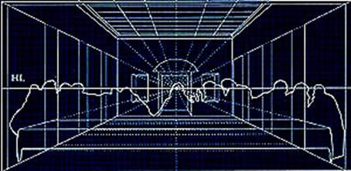
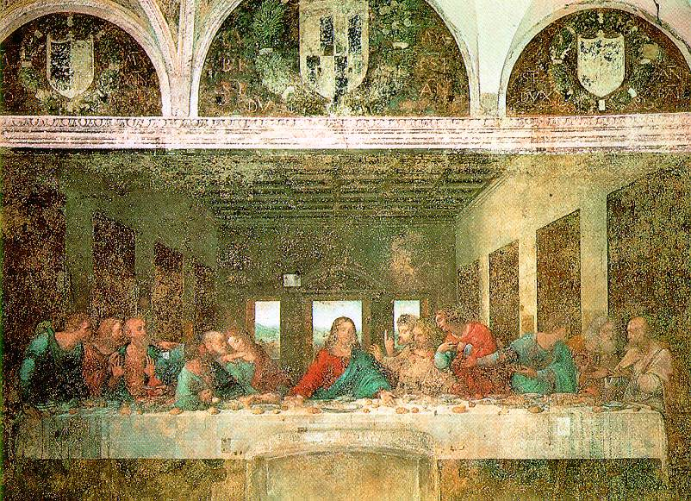
Art of Perspective
“Mr. King provides a lively account of Leonardo’s continual hunt for faces he might sketch, and speculates about the identity of the models (including himself) that he might have used to create the faces of Jesus and the apostles. He also writes about how Leonardo presumably started the painting by hammering a nail into the plaster to mark “the very center of the mural, the point on which all lines and all attention would converge: the face of Christ,” and how he used perspective and his knowledge of geometry and architecture to map out the rest of the painting.”
Leonardo da Vinci, The Last Supper (1495)
Ross King, ‘Leonardo and “The Last Supper” ’

Slide 9
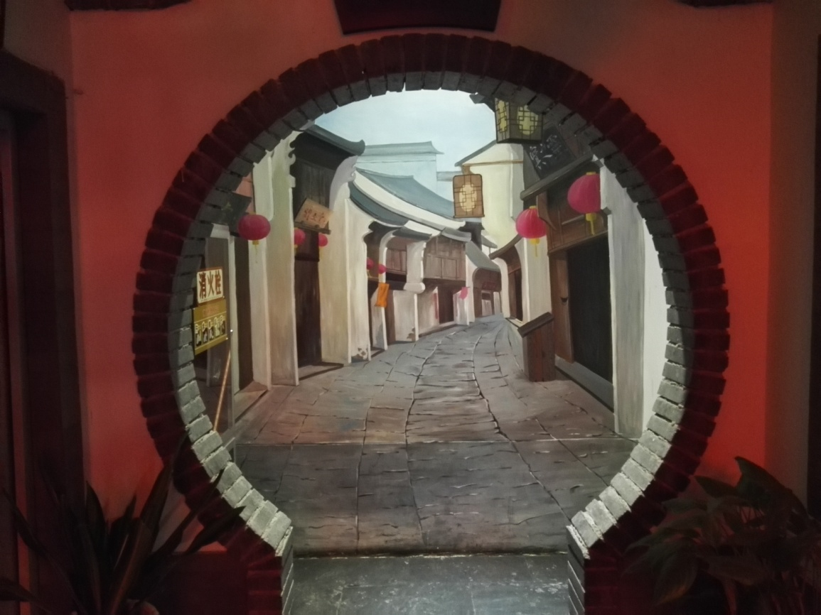

Slide 10
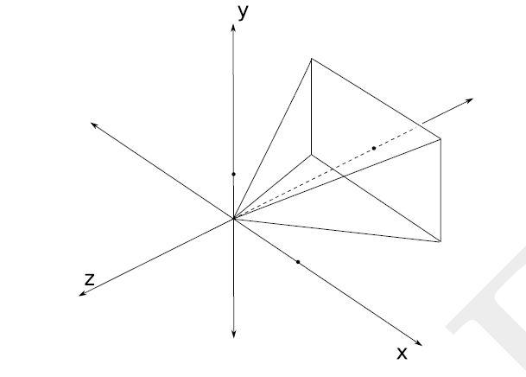
The film plane
Film plane is a plane in world space – 3D scene is projected onto a rectangle (the film) on that plane using some projection transformation and from there onto the viewport on screen
Film for our camera model will be perpendicular to and centered around the camera’s look vector, and will match dimensions of our view volume
Actual location of film plane along look vector doesn’t matter as long as it is between eye/COP and scene
Look Vector
Look Vector
Film Plane
Film
Plane
<number>/31

Slide 11
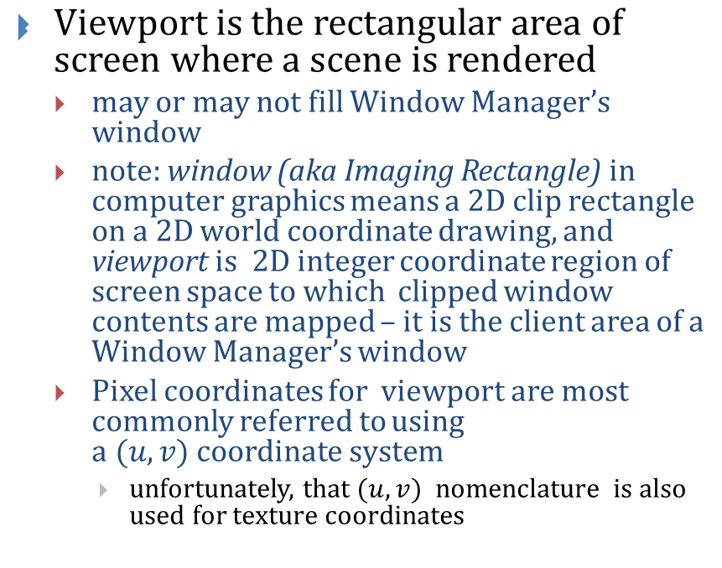
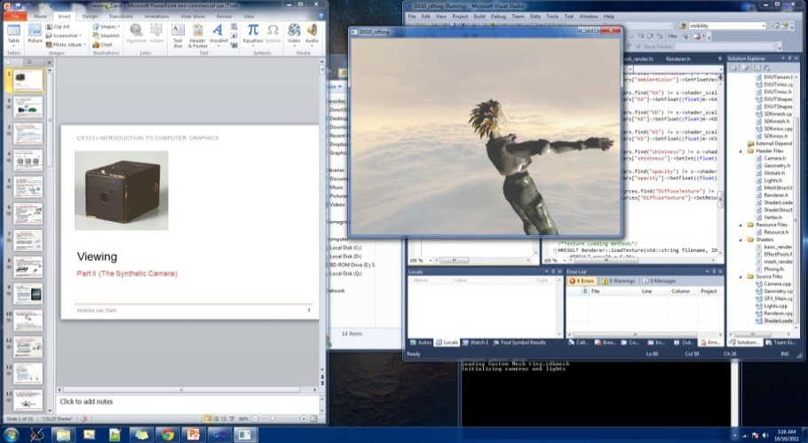
The viewport
<number>/31
Notes:
viewing window terminology-viewing window

Slide 12
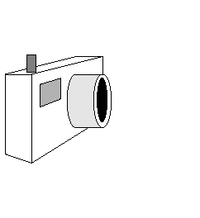
Constructing the view volume (1/2)
We need to know six parameters about our synthetic camera model in order to take a picture using our perspective view frustum
Position of camera (from where it’s looking)
Look vector specifies direction camera is pointing
Camera’s Orientation is determined by Look vector and angle through which the camera is rotated about that vector, i.e., the direction of Up vector in world
Up vector
Look vector
Position
<number>/31

Slide 13
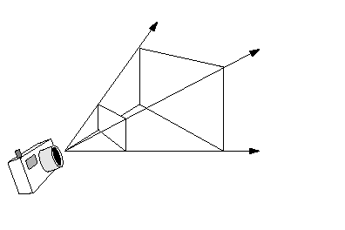
Constructing the view volume (2/2)
Aspect ratio of the electronic “film:” ratio of width to height
Height angle: determines how much of the scene we will fit into our view volume; larger height angles fit more of the scene into the view volume (width angle determined by height angle and aspect ratio)
  the greater the angle, the greater the amount of perspective distortion
Front and back clipping planes: limit extent of camera’s view by rendering (parts of) objects lying between them and throwing away everything outside of them – avoids problem of having far-away details map onto same pixel, i.e., sampling error
Optional: Focal length: objects at focal length are sharp, objects closer/farther are blurry
Width angle
Height angle
Front clipping plane
Back clipping plane
<number>/31

Slide 14
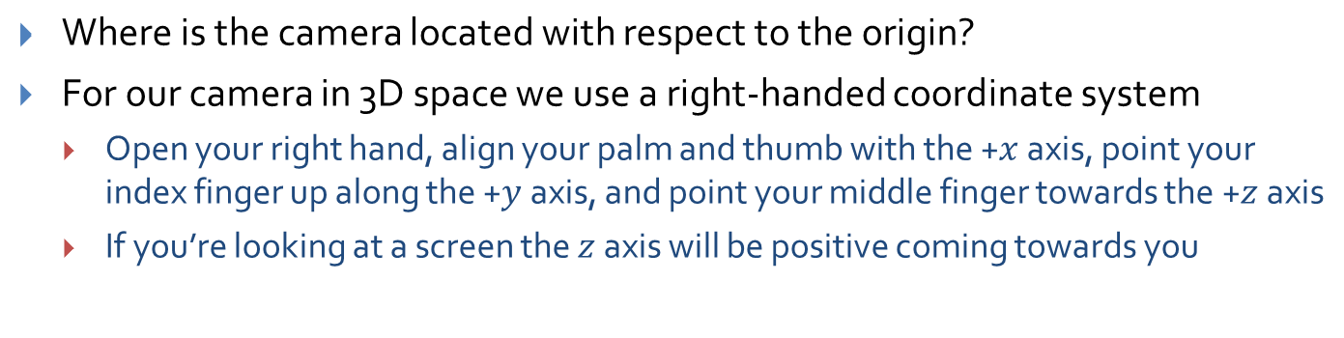
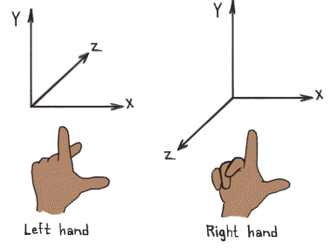
1) Position (1/1)
Courtesy of http://viz.aset.psu.edu/gho/sem_notes/3d_fundamentals/gifs/left_right_hand.gif
<number>/31

Slide 15
2 & 3) Orientation: Look and Up vectors (1/2)
Orientation is specified by a point in 3D space to look at (or a direction to look in) and an angle of rotation about this direction
  Note: gluLookAt() expects a point in 3D space to determine its look vector
These correspond to the look vector and up vector
In diagram below, camera is positioned at origin, but that isn’t typical
y
x
-z
Up vector
point to look at (x’, y’, z’)
Look vector
camera Position
z
<number>/31

Slide 16
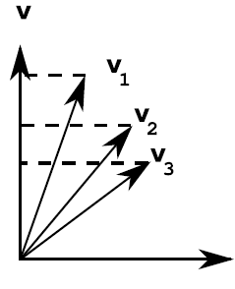
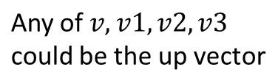
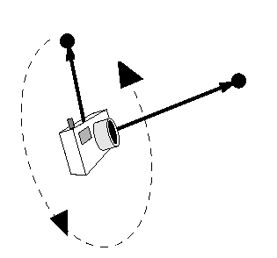
2 & 3) Orientation: Look and Up vectors (2/2)
Look Vector
  Direction the camera is pointing
  Three degrees of freedom; can be any vector in 3-space
Up Vector
  determines how camera is rotated around Look vector
  for example, holding camera horizontally or vertically
  Up vector must not be parallel to Look vector but it doesn’t have to be perpendicular either– actual orientation will be defined by component of vector perpendicular to Look vector, lying in plane with Look as normal
Look Vector
Up vector
Look vector
Projection of Up vector
Position
<number>/31

Slide 17
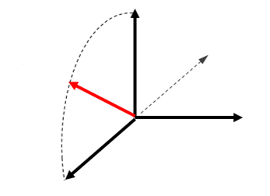





The camera coordinate space (1/2)
The equivalent of x, y and z axes in camera space are unit vectors u, v and w (not to be confused with homogenous coordinate, w)
  Also a right handed coordinate system
  w is a unit vector in the opposite direction of the look vector
  v is the part of the up vector perpendicular to the look vector, normalized to unit length
  u is the unit vector perpendicular to both v and w
<number>/31

Slide 18
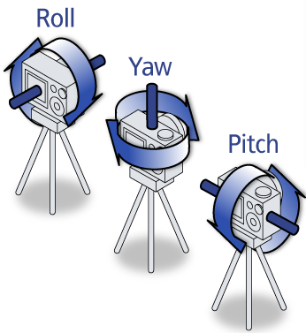


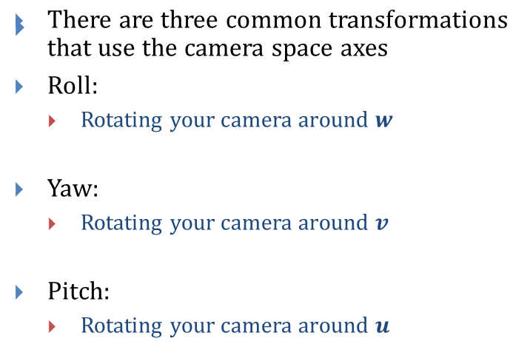





The camera coordinate space (2/2)
Send camera to origin and align axes with the standard axes, then use our rotation matrices to perform these transformations and then un-align and un-translate.
Roll, Yaw, Pitch image courtesy of http://3.bp.blogspot.com/_dbbuwCxZzCE/TQuhLBALxJI/AAAAAAAAAAo/oV8D5B4YijQ/s1600/pry.png
<number>/31

Slide 19
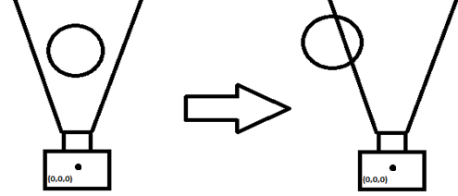
Aside: The Camera as a model
There are different ways we can model a camera
In the generalized model we have a camera and a scene where both the camera and objects in the scene are free to be transformed independently
In a more restricted model we have a camera that remains fixed in one position and orientation
  To transform the camera we actually apply inverse transformation to objects in scene
This is the model OpenGL uses; note however that GLU abstracts this concept away from the programmer (gluLookAt())
Translate “camera”
to the right
Field of view in OpenGL can be thought of as view of camera at origin looking down –z axis
Object moves to
left to simulate
a camera moving to right

Slide 20
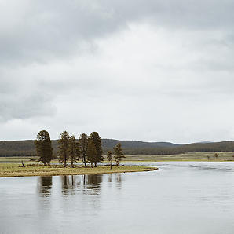

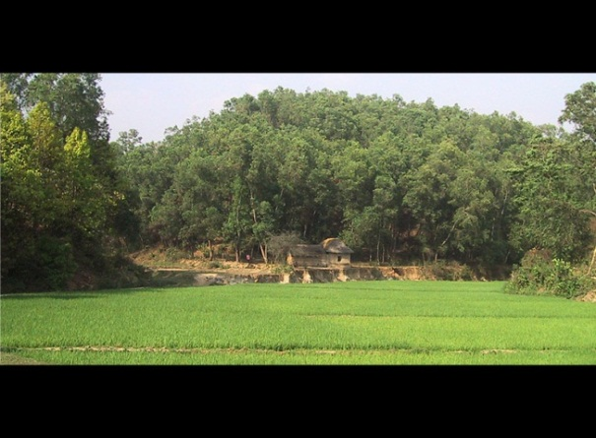
4) Aspect Ratio (1/1)
courtesy of http://www3.flickr.com/photos/zerogrizzly/4037144257/
Analogous to dimensions of film in camera
Ratio of width to height of viewing window
Viewport’s aspect ratio usually defined by device being used
  square viewing window has a ratio of 1:1
  NTSC TV is 4:3, HDTV is 16:9 or 16:10
Aspect ratio of viewing window defines dimensions of image that gets projected to film plane, after which it is mapped to viewport
  typically it’s a good idea to have same aspect ratio for both your viewing window and viewport, to avoid distortions/ stretching
  Note: the black strips on the images is a technique called letter boxing. It preserves the aspect ratio of the image when the screen can’t accommodate it. This is in contrast to simply stretching the image which distorts the images, and most notably, faces.
Courtesy of http://dvdhound.hubpages.com/hub/Blue-Ray-Vs-DVD-Upconversion
1:1
16:9
Courtesy of http://www.geniusdv.com/weblog/archives/widescreen%20image.jpg
2:1
<number>/31

Slide 21
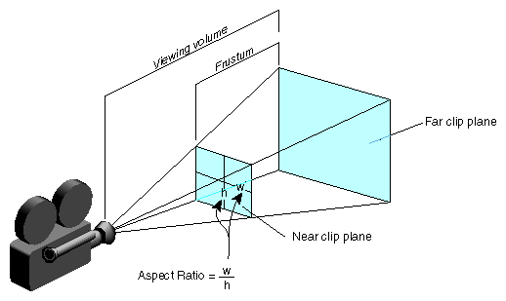
5) View Angle (1/2)
Determines amount of perspective distortion in picture, from none (parallel projection) to a lot (wide-angle lens)
In a frustum, two viewing angles: width and height angles
  Usually width angle is specified using the height angle and aspect ratio
Choosing View angle analogous to photographer choosing a specific type of lens (e.g., a wide-angle or telephoto lens)
Width angle
The aspect ratio is defined
by width/height
Height angle
<number>/31

Slide 22
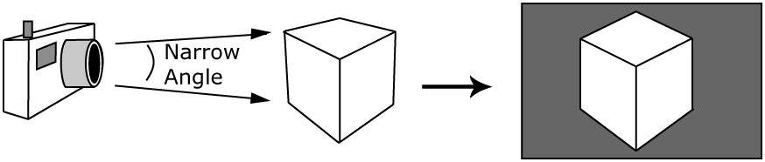
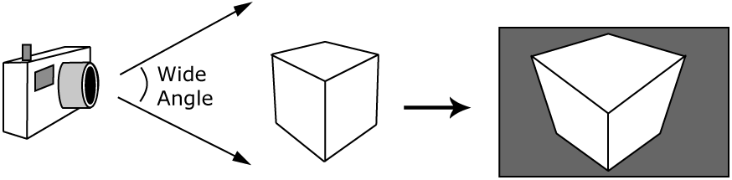
5) Viewing Angle (2/2)
Lenses made for distance shots often have a nearly parallel viewing angle and cause little perspective distortion, though they foreshorten depth
Wide-angle lenses cause a lot of perspective distortion
Resulting picture
<number>/31

Slide 23
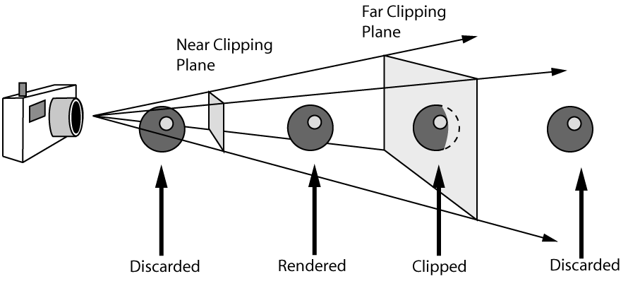
6) Near and Far Clipping Planes (1/3)
With what we have so far we can define four rays extending to infinity define the edges of our current view volume
Now we need to bound front and back to make a finite volume -- can do this using the near and far clipping planes, defined by distances along look vector (Also note that our look vector and clipping planes are perpendicular)
This volume defines what we can see in the scene
Objects outside are discarded
Objects intersecting faces of the volume are “clipped”
<number>/31

Slide 24
6) Near and Far Clipping Planes (2/3)
Reasons for Front (near) clipping plane:
  Usually don’t want to draw things too close to camera
    would block view of rest of scene
    objects would be distorted
  Don’t want to draw things behind camera
    wouldn’t expect to see things behind camera
    in the case of perspective camera, if we were to draw things behind camera, they would appear upside-down and inside-out because of perspective transformation
<number>/31

Slide 25
6) Near and Far Clipping Planes (3/3)
Reasons for Back (far) clipping plane:
  Don’t want to draw objects too far away from camera
    distant objects may appear too small to be visually significant, but still take long time to render
    by discarding them we lose a small amount of detail but reclaim a lot of rendering time
    can also help to declutter a scene
These planes need to be properly placed, not too close to the camera, not too far (mathematical justification later)
<number>/31

Slide 26
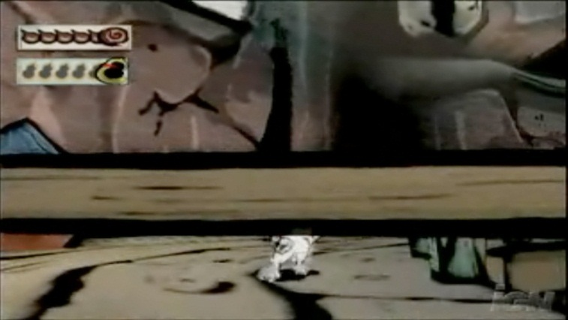
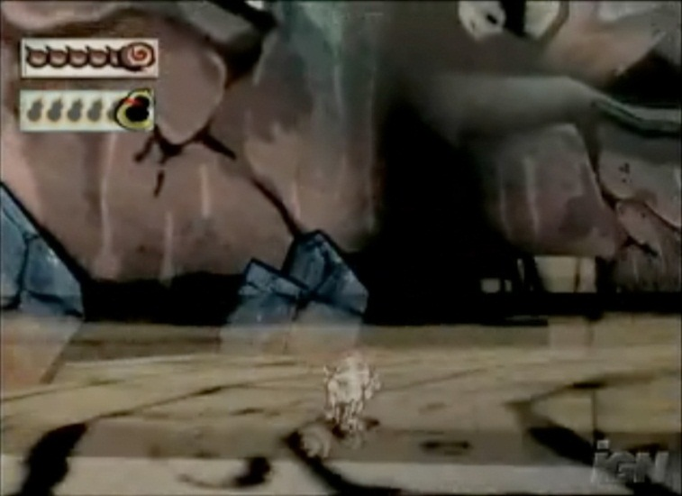
Games and Clipping Planes (1/2)
Sometimes in a game you can position the camera in the right spot that the front of an object gets clipped, letting you see inside of it.
Video games use various techniques to avoid this glitch. One technique is to have objects that are very close to the near clip plane fade out before they get cut off, as can be seen below
This technique gives a clean look while solving the near clipping problem (the wooden fence fades out as the camera gets too close to it, allowing you to see the wolf behind it).
Fence is
opaque
Fence is
partially
transparent
Screenshots from the game, Okami
<number>/31

Slide 27
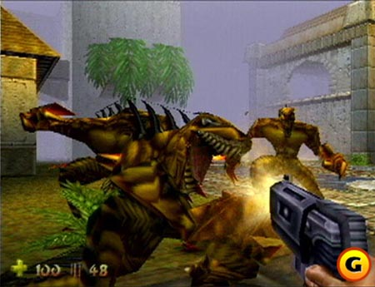

Games and Clipping Planes (2/2)
Ever played a video game and all of a sudden some object pops up in the background (e.g., a tree in a racing game)? That’s object coming inside far clip plane.
Old solution, add fog in the distance. A classic example, Turok: Dinosaur Hunter
Modern solution, dynamic level of detail: mesh detail increases as you get closer
Thanks to fast hardware and level of detail algorithms, we can push the far plane back now and fog is much less prevalent
Turok image courtesy of http://www.atomicgamer.com/screenshots/game-1552/10965-800.jpg
Stone Giant image courtesy of http://images.tweaktown.com/news/1/4/14981_07.jpg
<number>/31

Slide 28

Focal Length
Some camera models take a Focal length
Focal Length is a measure of ideal focusing range; approximates behavior of real camera lens
Objects at distance equal to Focal length from camera are rendered in focus; objects closer or farther away than Focal length get blurred
Focal length used in conjunction with clipping planes
Only objects within view volume are rendered, whether blurred or not. Objects outside of view volume still get discarded
Courtesy of http://3d-pic.3ddl.net/uploads/allimg/110617/13-11061G05J20-L.jpg
<number>/31

Slide 29
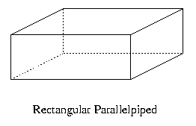
The Parallel View Volume (1/2)
Up until now we’ve been describing the specifications for a perspective view volume
We also need to discuss the parallel view volume (as mentioned last time, used for orthogonal/metric views)我们还需要讨论并行视图的体积（如上次提到的，用于正交/度量视图）
What do we need to know this time?
  Everything we wanted for a perspective view volume except for width and height angles, replaced by just a width and height (also the width and height of our film on our film plane)我们需要的透视图体积的所有内容（宽度和高度角度除外）都由宽度和高度（以及胶片在胶片平面上的宽度和高度）代替
  A parallel view volume is a parallelepiped (all opposite edges parallel)平行视图体积是平行六面体（所有相对边缘平行）
<number>/31

Slide 30
The Parallel View Volume (2/2)
Width
Far distance
Height
Look vector
Near distance
Projection of
up vector
Up vector
Position
Objects appear the same size no matter how far away they are since projectors are all parallel
A benefit of the parallel view volume is that it’s really easy to project a 3D scene to a 2D medium
<number>/31

Slide 31
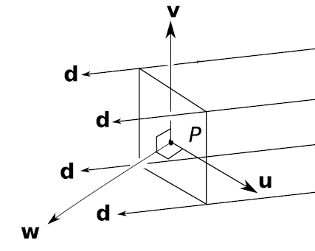
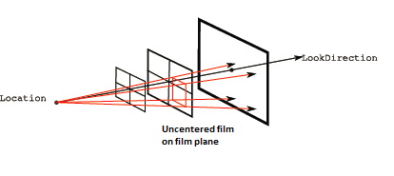
Capabilities of the Generalized Camera (1/2)
In a more generalized camera the viewing window doesn’t have to be centered about the Location+LookDirection
Nor does it have to be perpendicular to the LookDirection
This allows us to use a more flexible view as well as enable the use of more view types
Using an uncentered film we can essentially choose which part of our original perspective projection to view
w
<number>/31

Slide 32
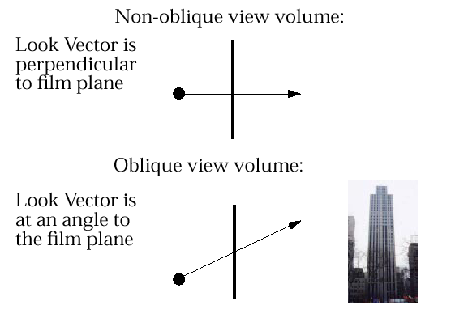
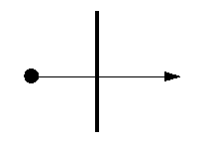

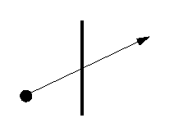
Capabilities of the Generalized Camera (2/2)
Using a parallel view volume we can do oblique projections (cavalier, cabinet, perspective oblique) where the look vector/projectors and film plane aren’t perpendicular:
Our model of a camera is not all encompassing
There are some capabilities that we have omitted for the sake of simplicity
Our film is centered around the camera position and always perpendicular to the look vector
Non-oblique perspective view volume:
Oblique perspective view volume:
Look vector is
perpendicular
to film plane
Look vector is
at an angle to
the film plane
<number>/31

Slide 33
Next Task…
We have now seen how to construct a perspective and parallel view volume and we mentioned how a scene is projected in these volumes onto the film plane
But these view volumes can be located anywhere and positioned in any way depending on how our camera is specified
How can we transition from knowing what the view volume looks like to actually rendering an image to the screen
Next, describe canonical view volume and how we can use it for rendering
PS: Get ready for some use of our linear algebra transformations!
31/31

